Slide 1
Comparing hospital Efficiency in Hard-to-reach and non-hard-to-reach Areas in Bangladesh
Sayem Ahmed, PhD
Lecturer in Health Economics
Brunel University London
sayem.ahmed@brunel.ac.uk
https://sayemahmed.org/
23 July 2025

Slide 2
Background
28 million Bangladeshis (21% of population) are living in 25% of the country’s hard-to-reach areas
They are facing barriers to access healthcare due to insufficient drug availability, human resources, transportation, limited knowledge, and out-of-pocket expenses

Slide 3
Objectives
Teesta river in dry season
The study's aim was to assess the association between hart-to-reach (HTR) area characteristics and the technical efficiency of secondary-level hospitals.
3
Notes:
Photo source: https://link.springer.com/article/10.1007/s44282-025-00137-0/figures/4

Slide 4
Methods
Efficiency analysis framework
Input
Labor: physicians, nurses, administrative staffs
Production process
Output
ANC recipients
Capital: hospital beds
No. of deliveries
Outpatient visits
No. of admission
Supplies
PNC recipients
Emergency visits
62 Secondary-level Hospitals
Geographic characteristics, such as beel/wetland, coastal, offshore island, saline, and hilly areas, were categorized as HTR areas (World Bank, 2012)
Input and output data for each hospital were extracted from the Local Health Bulletin-2022
Data envelopment analysis was performed with output orientation
Efficiency scores of 62 hospitals using both constant and variable returns to scale assumption were estimated
Test-of-hypothesis and Multiple Tobit regression models were employed to determine the association between HTR area characteristics and hospital efficiency
4

Slide 5
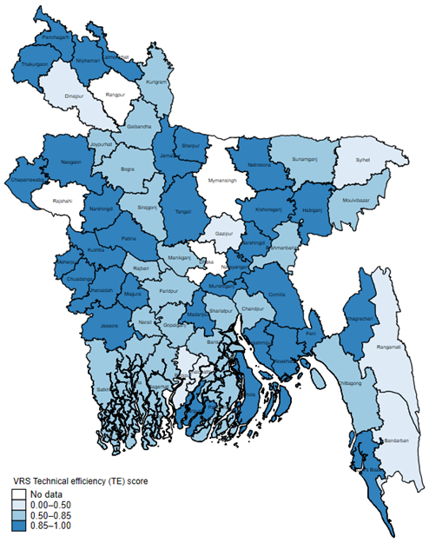
Results
VRS technical efficiency scores of secondary level hospitals in Bangladesh
Hospitals were 80% efficient using variable returns to scale assumptions
Hospitals located in HTR areas were less technically efficient (efficiency score = 0.76) than those in non-HTR areas (efficiency score = 0.84; p-value = 0.08),
HTR areas experience lower hospital efficiency scores (coefficient = 0.258; p-value < 0.05) than hospitals in non-HTR regions.
Additionally, the bed occupancy ratio and average length of stay were significantly associated with the efficiency scores of secondary-level hospitals.
5

Slide 6
Conclusions and recommendations
Hospitals in HTR regions are found to be less technically efficient than non-HTR regions in Bangladesh.
Targeted interventions such as improving healthcare access for vulnerable HTR area populations, optimizing bed occupancy rates and length of stay with proper referral systems and discharge planning in these particular areas
further research on health systems in climate vulnerable areas in Bangladesh should be prioritized to address these challenges effectively.
6

Slide 7
Thank you!
sayem.ahmed@brunel.ac.uk
7
Notes:
Photo source: https://file.mofa.gov.bd//media//6722e37a-8b7d-4753-b6ab-04ec507e0f25//ba.jpg

Slide 8
Mean technical efficiency scores of hospitals by HTR categories
Technical efficiency score | HTR area (N=30) |  |  | Non-HTR area (N=32) |  |  | P-valueª
 | Mean | Std. Err. | 95% CI | Mean | Std. Err. | 95% CI
CRS | 0.68 | 0.04 | (0.61-0.75) | 0.77 | 0.04 | (0.69-0.86) | 0.06
VRS | 0.76 | 0.04 | (0.69-0.84) | 0.84 | 0.04 | (0.76-0.91) | 0.08
Scale | 0.89 | 0.01 | (0.86-0.92) | 0.92 | 0.02 | (0.88-0.96) | 0.27
Hospitals located in HTR areas were less technically efficient than those in non-HTR areas

Slide 9
The sensitivity analysis of efficiency scores
The sensitive scenarios were,
Excluding the number of hospital outpatient visits (OPD) was as outcome
Excluding number of beds from the DEA
Excluding physicians from the DEA model
9

